Slide 1
RNS Institute of Technology Bengaluru
Department of Information Science and Engineering
RESTAURANT DBMS
Submitted by –
Akash Hegde 1RN14IS010
Akshay Sudhir Hulekal 1RN14IS013
Hitesh B Rao 1RN15IS406

Slide 2
Abstract
A restaurant is a place which is frequented by a lot of customers to have food and satiate their appetite.
A typical customer-restaurant transaction involves placing the order to a particular manager, which is then prepared by the chefs and delivered to the customer by a waiter.
Each order contains one or more items. These items have their own description and price.
Once the customer has had his/her meal, a bill is generated with reference to the order placed by that customer. This is then paid by the customer to complete the transaction.
Thus, a database has to be maintained in an organized manner to keep track of these transactions.

Slide 3
Requirements
The entities “Manager” and “Customer” are required to save details of all managers (irrespective of the cuisine) and all the customers who visit the restaurant, respectively.
The “Order” entity ensures that any order placed by a customer to a particular manager is maintained properly.
The “Item” entity has details of all the items in the menu of that particular restaurant.
Finally, the entity “Bill” keeps track of the bills generated by orders placed by customers. It includes the date when the bill was generated as well as the total amount.

Slide 4
Scope
Need for Home Delivery of items from the restaurant.
Implementing an application that can make ordering of items easier than what it is currently.
Efficient management of the restaurant by maintaining a proper database.
Use of the database for future references and transactions.

Slide 5
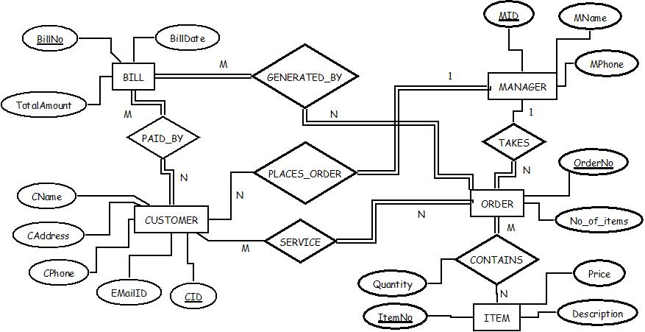
E-R Diagram

Slide 6
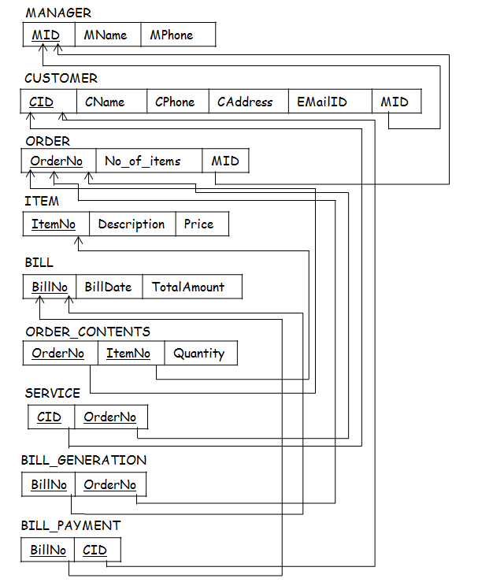
Schema Diagram
MANAGER
MID | MName | MPhone
CUSTOMER
CID | CName | CPhone | CAddress | EMailID | MID
ORDER
OrderNo | No_of_items | MID
ITEM
ItemNo | Description | Price
BILL
BillNo | BillDate | TotalAmount
ORDER_CONTENTS
OrderNo | ItemNo | Quantity
SERVICE
CID | OrderNo
BILL_GENERATION
BillNo | OrderNo
BILL_PAYMENT
BillNo | CID

Slide 7

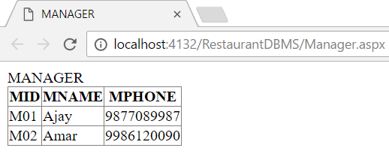
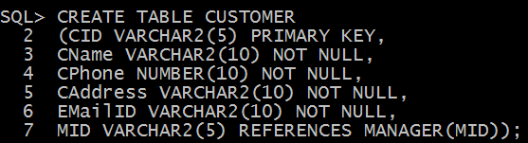
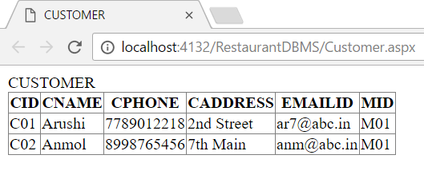

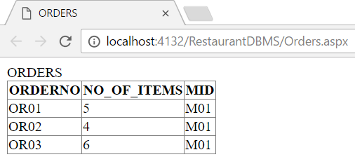
Tables
MANAGER
CUSTOMER
ORDERS

Slide 8

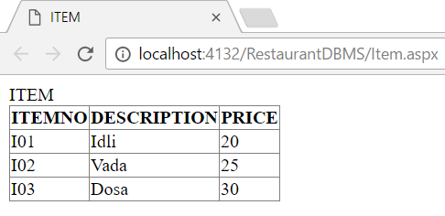

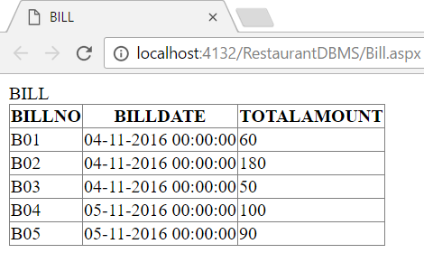
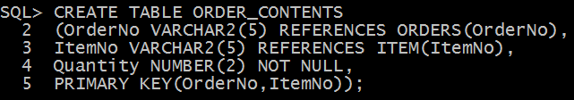
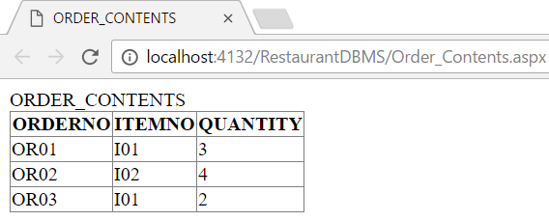
ITEM
BILL
ORDER_CONTENTS

Slide 9

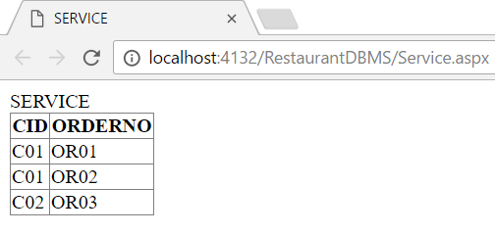

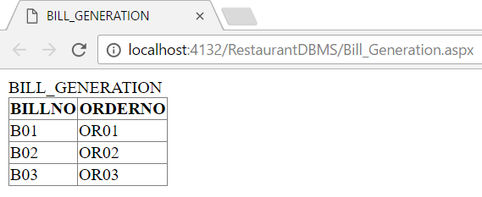

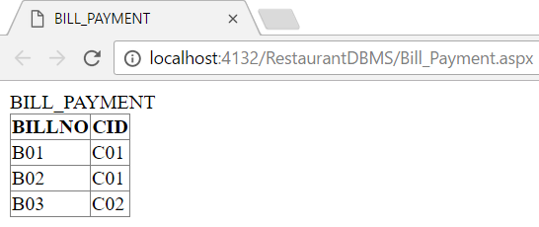
SERVICE
BILL_GENERATION
BILL_PAYMENT

Slide 10
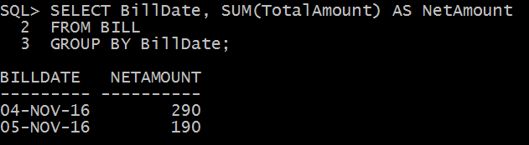
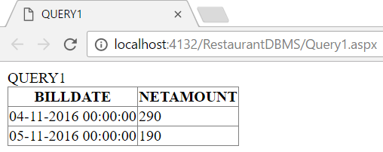
Queries and Generated Reports
1. Find the total amount generated by bills on each day, in the restaurant.

Slide 11
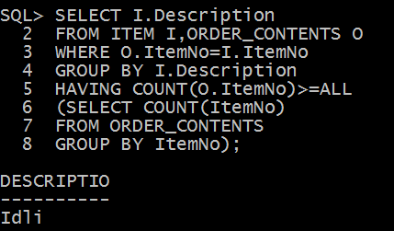
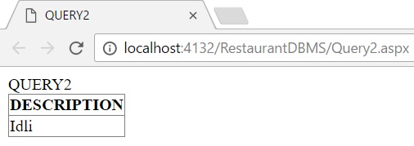
2. Find the item which is ordered the most.

Slide 12
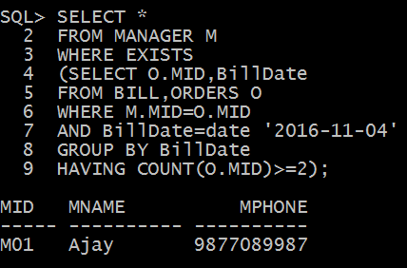
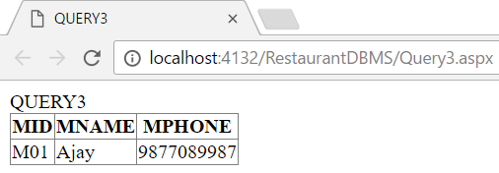
3. Display details of the manager who takes at least 2 orders on a specific day.

Slide 13
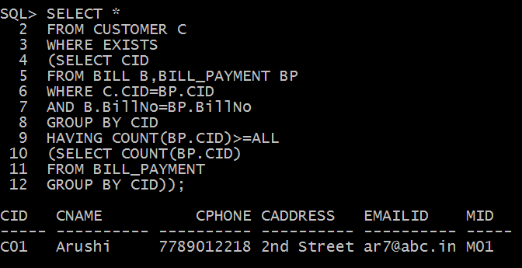
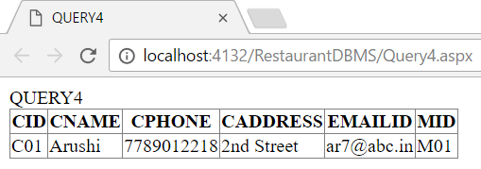
4. Display the details of the customer who visits the restaurant most frequently.

Slide 14
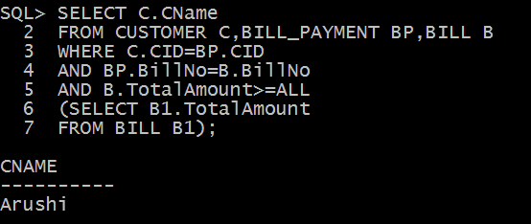
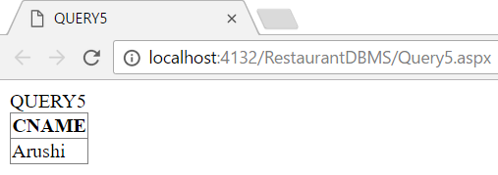
5. Find the name of the customer who pays the highest bill amount.

Slide 15
Conclusion
A Restaurant DBMS aims to provide a user-friendly experience to its users as one can obtain the details of the restaurant and its features and functions at a glance.
This makes the management of that particular restaurant easier, organized and more efficient.
Many more entities and corresponding relationships can be added to the Restaurant DBMS for a wider perspective of how a restaurant works.
Integration of this database into applications containing a GUI can be made so that all users can access data easily, without having to sift through the back-end.

Slide 16
Thank You ☺

